Slide 1


Git + Git Flow

Slide 2
Why git?
Save all your code changes
Allow working on the same piece of code by multiple developers

Slide 3
Terms
Git – The name of the software, divided into git server and git client
Git Server – Where you host your code
Git Client – Which you use to talk to server
Repository – The place you store your code, there’s one on server and one on each client
GitHub/BitBucket – The one who provide GUI to manage our server side repository. Also the one who steal everyone’s code.* 🌚
* That’s why it’s more common for corporates to set up their private git server.
Notes:
Repository → think it as a folder
They also charge you from cicd

Slide 4
Git

Slide 5
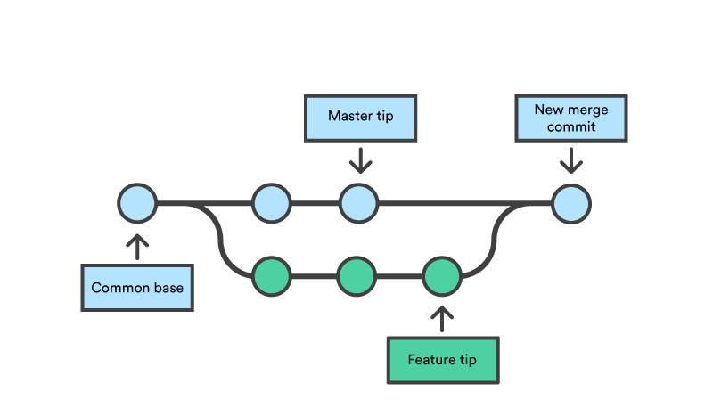
Git
This is also known as master branch
Notes:
What is a branch → it is like a pointer

Slide 6
Git
What is a “Branch”?

Slide 7
Git - branches
Branch is pointer.
Git keep information about which is the current pointer.
New commit is grown from the current pointed commit.
Notes:
Usaully developers directly work in git folders.

Slide 8
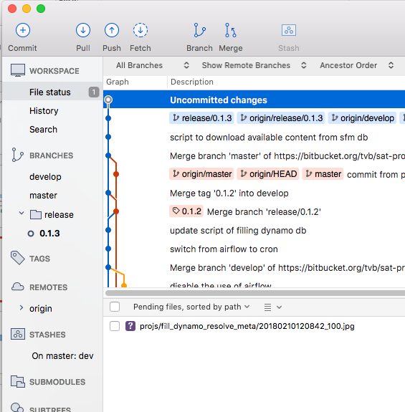
Git - Commit
High level commit involve 3 steps
Add
Stage
Commit
In SourceTree, “uncommitted changes” refers to “not added or not staged or not committed”

Slide 9
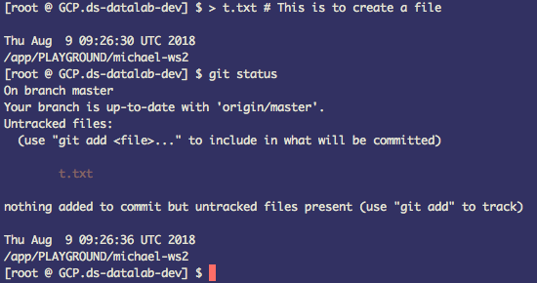
Git - Commit
High level commit involve 3 steps
Add
Stage
Commit
In SourceTree, “uncommitted changes” refers to “not added or not staged or not committed”
In command line, add and commit are separated

Slide 10
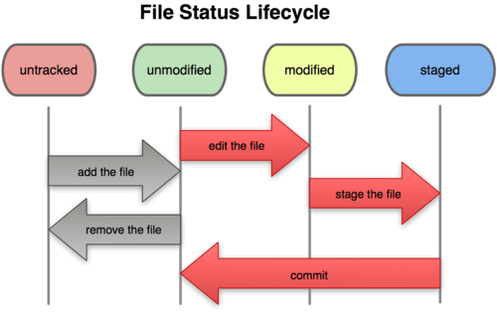
Git - commit

Slide 11
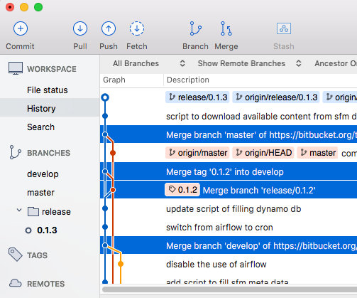
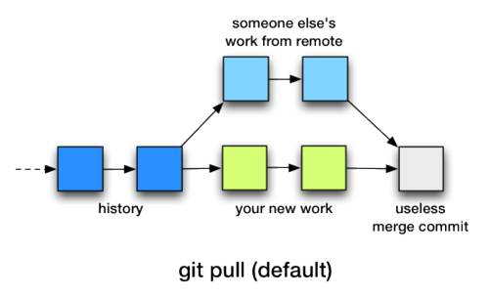
Git – Pull/Merge
New “Commit” is generated once you pulled and merged.

Slide 12
Git – Pull/Merge
How about the merge failed?
Example:
In current working copy, I put
username = "jimmy"
but developer B put
username = "michael"
at the same line in the same piece of code.
The merged piece of code will be kept uncommitted. (Just like when you have uncommitted changes)

Slide 13
Git – In case of conflict
# After the merge,
# In the code we have:
…
<<<<<<<< HEAD
username = "jimmy"
========
username = "michael"
>>>>>>>> origin/master
…
To resolve, we can:
Open the file with text editor, edit the code to that you believe to be correct.
Use some third party diff tool
In SourceTree, press “use mine” or “use theirs”

Slide 14
Git – Push
Push mean to upload the commits that exist on your local repository but not on the remote one.
After commit, you must pull/merge to ensure you are ahead of the version on server, otherwise your push request will be rejected.
Cannot directly push at this stage.

Slide 15

Git – Push
Before
After

Slide 16
Git Flow
A working standard on top of Git

Slide 17
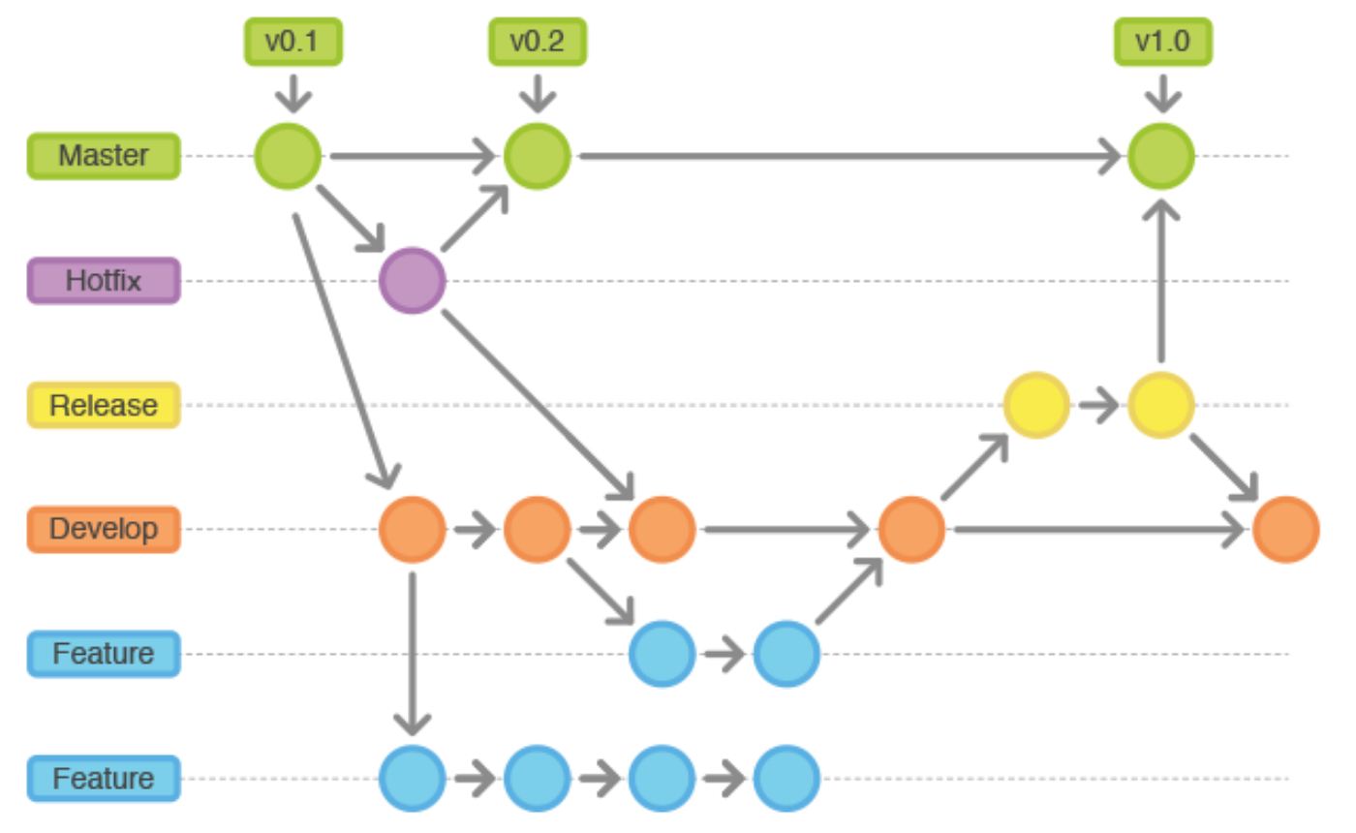

Slide 24
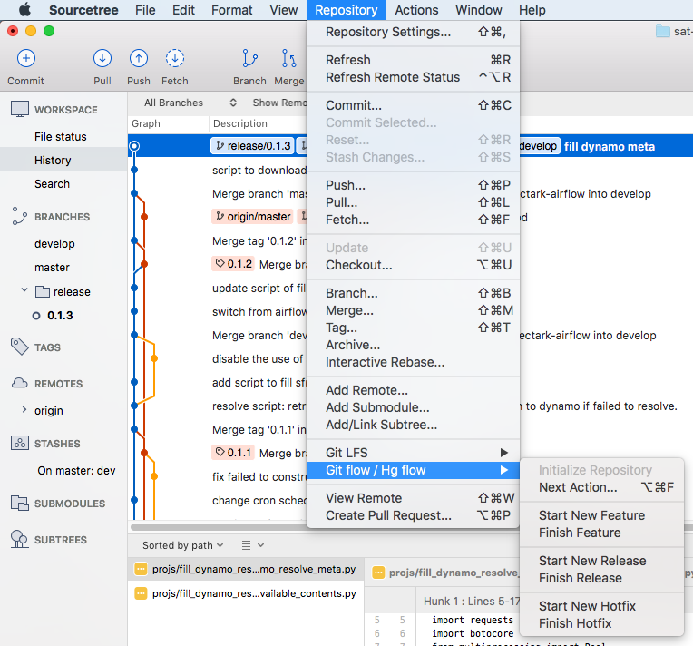
Git Flow in SourceTree
Git does not have any support about Git Flow.
Git Flow is purely enforced by SourceTree.
We need to initialize git flow at every SourceTree environment.

Slide 25
Git command line cheatsheet
https://education.github.com/git-cheat-sheet-education.pdf

